Slide 1

Lab 1: Setting up your virtual lab
SEC 336 – Liza hmad

Slide 2
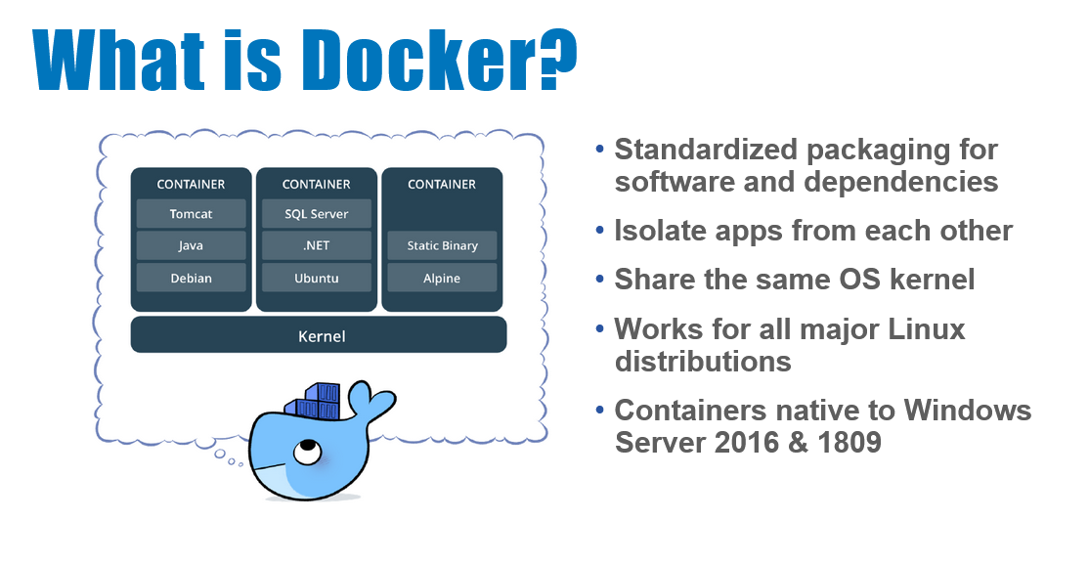

Slide 3
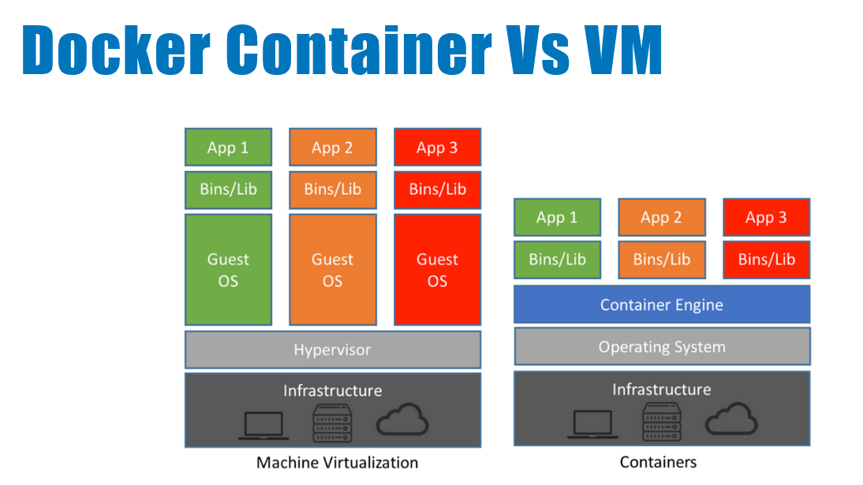

Slide 4
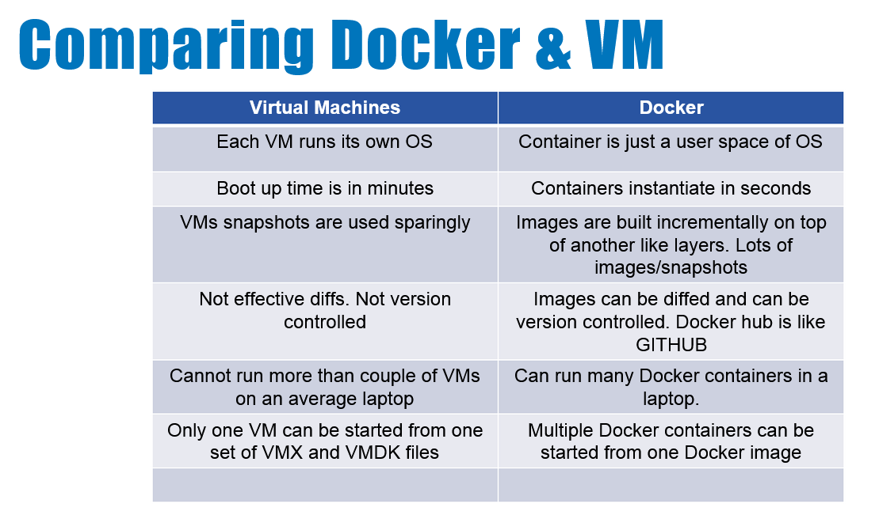
Notes:
http://dockerlabs.collabnix.com/docker/Docker_VIT_Intro/Docker_VIT_Intro.html

Slide 5
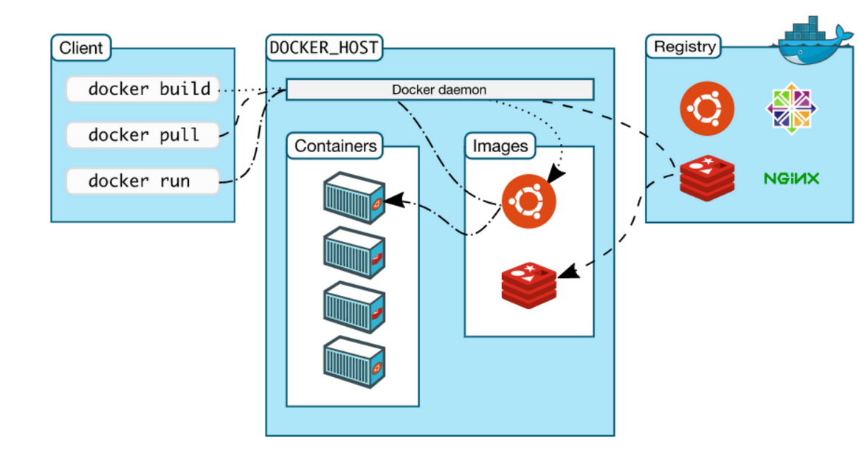

Slide 6
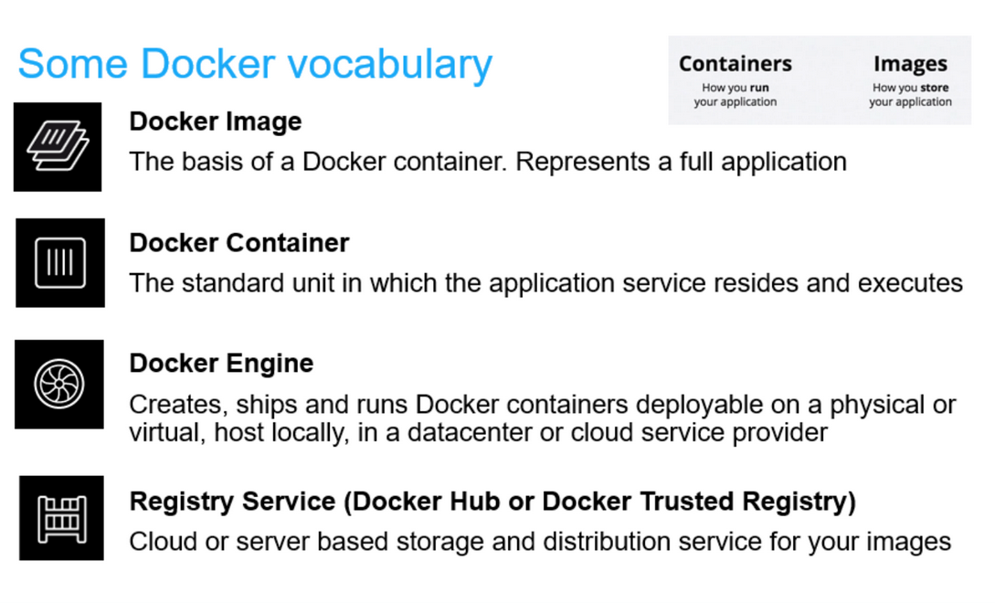

Slide 7
Docker images
Kali:
Kali Linux is a Debian-based Linux distribution aimed at advanced Penetration Testing and Security Auditing.
Kali-linux-top-10: aircrack-ng, burbsuite, hydra,john, maltego, Metasploit framework, nmap, owasp-zap, sqlmap, wireshark
Scapy
Alpine:
Alpine Linux is a Linux distribution designed for security, simplicity, and resource efficiency. Because of its small size, it is commonly used in containers providing quick boot-up times.

Slide 8

Lab 1: Password Cracking and Network Attacks

Slide 9
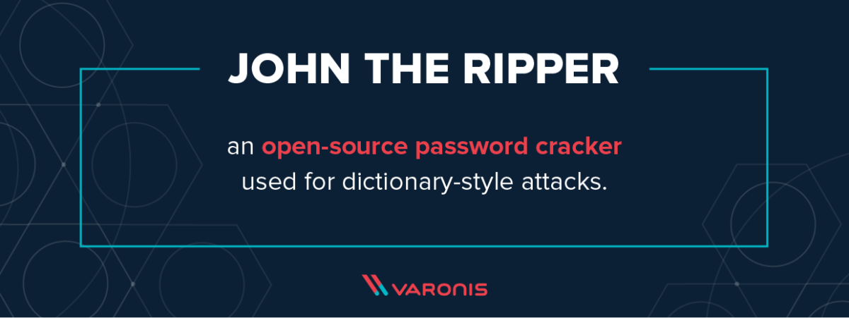

Slide 10
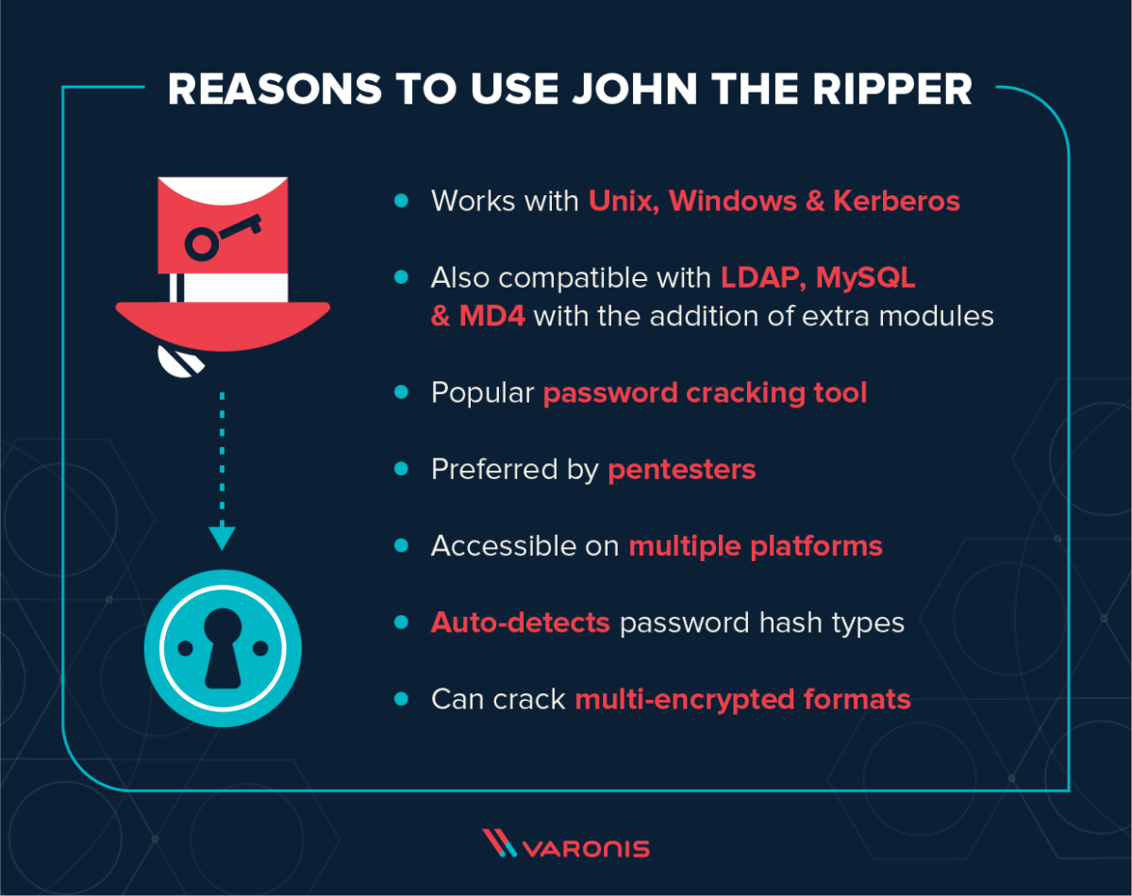

Slide 11
John the Ripper
JtR can also be used during pentesting exercises that can help IT staff spot weak passwords and poor password policies.

Slide 12
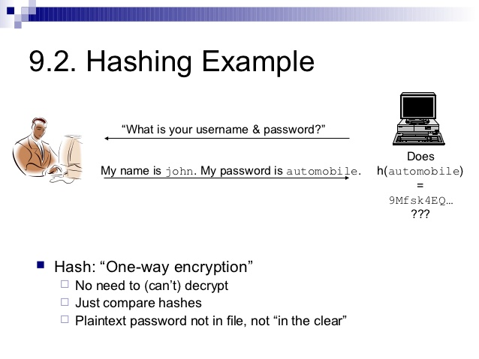
Password Security

Slide 13
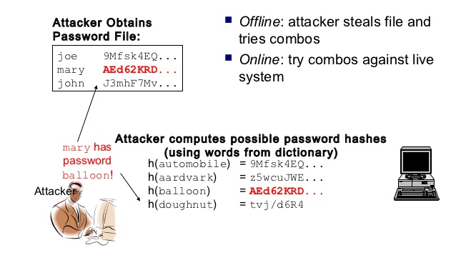
Password Attacks

Slide 14


Slide 15
ARP: Address Resolution Protocol
Address Resolution Protocol (ARP) is a network protocol used to find the hardware (MAC) address of a host from an IP address. ARP is used on Ethernet LANs because hosts that want to communicate with each other need to know their respective MAC addresses. It is a request-reply protocol; ARP request messages are used to request the MAC address, while ARP reply messages are used to send the requested MAC address.

Slide 16
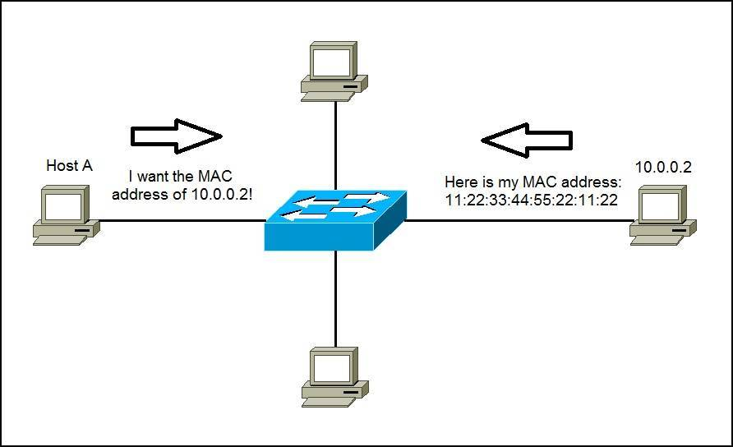
ARP: Address Resolution Protocol

Slide 17
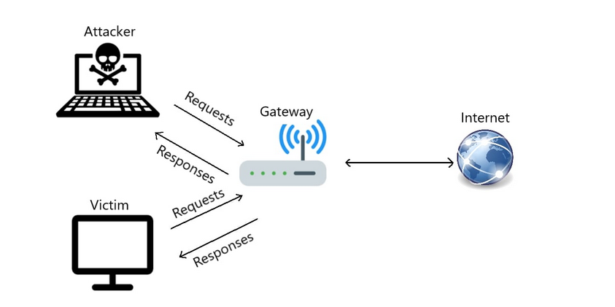

Slide 18
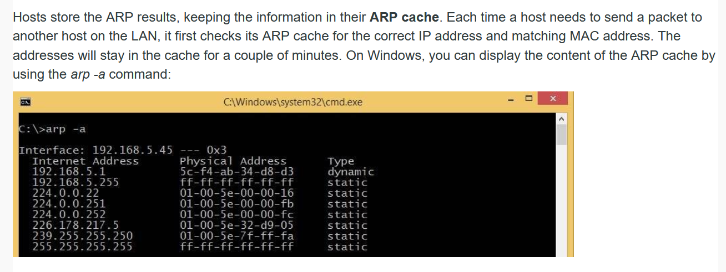
ARP cache

Slide 19
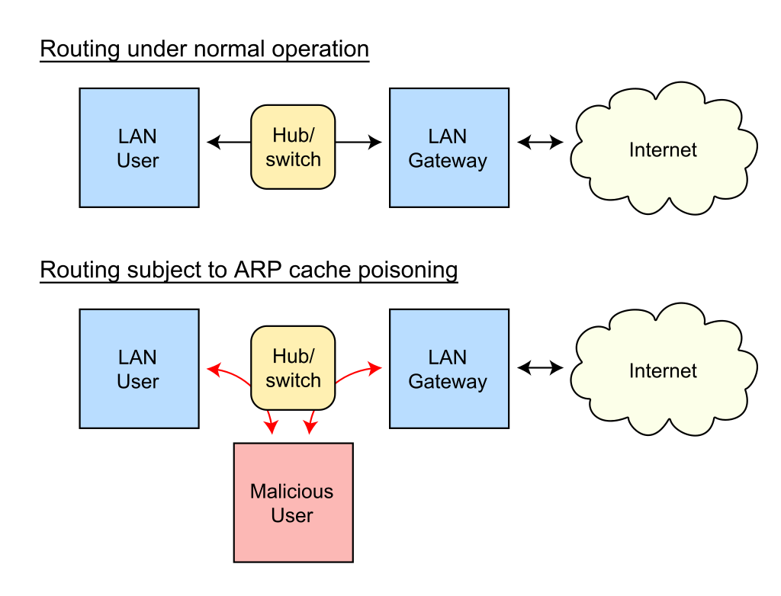
ARP Poisoning

Slide 20
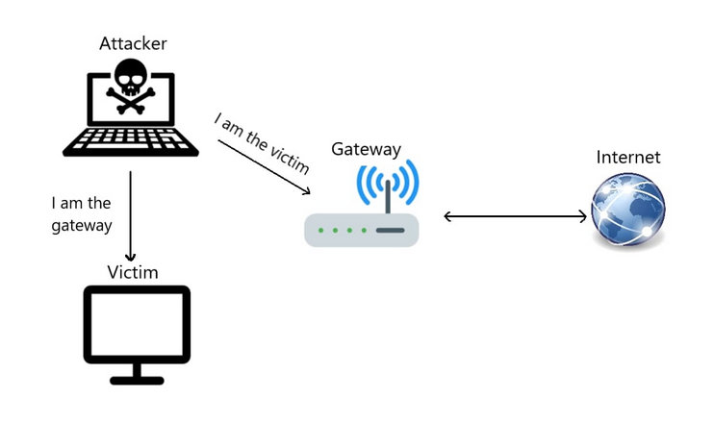
ARP Poisoning

Slide 21
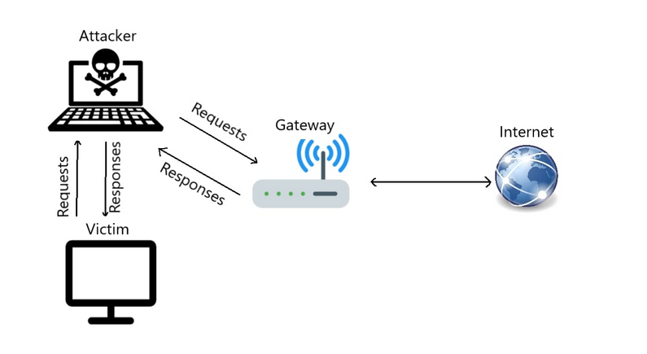

Slide 22
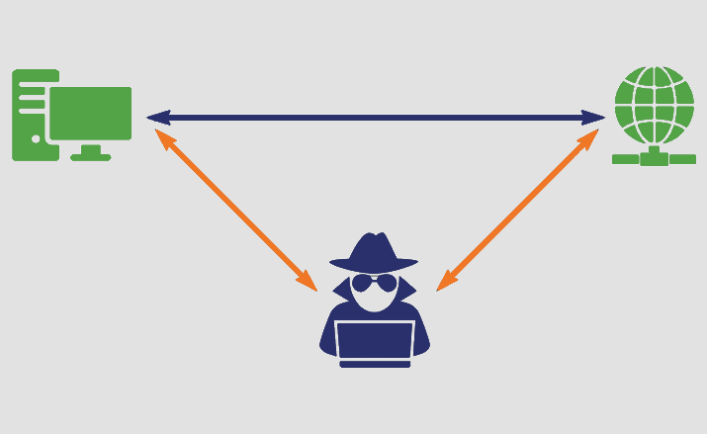
MITM: Man in the middle attack

Slide 23
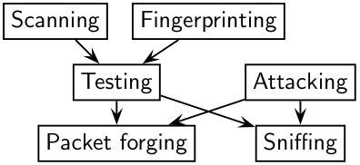
Scapy
Scapy is a Python program that enables the user to send, sniff and dissect and forge network packets. This capability allows construction of tools that can probe, scan or attack networks.

Slide 24
Scapy
Arp() : We use the ARP() function again to devise a packet that modifies the ARP table of the gateway

